Slide 1

Stage 2 Slave Squat Standards Course Designer: Eric Beerbaum
Carbine: 24 Handgun: N/A
The start position is Carbine loaded, safety on, stock touching belt, muzzle touching bottom mark.
String 1: On the audible start signal engage T1-T3 (the back targets) with two rounds each, freestyle. Conduct a mandatory reload and engage T4-T6 (the front targets) with two rounds each, strong shoulder only. String 2: On the audible start signal engage T1-T3 (the back targets) with two rounds each, freestyle. Conduct a mandatory reload and engage T4-T6 (the front targets) with two rounds each, weak shoulder only.

Slide 2
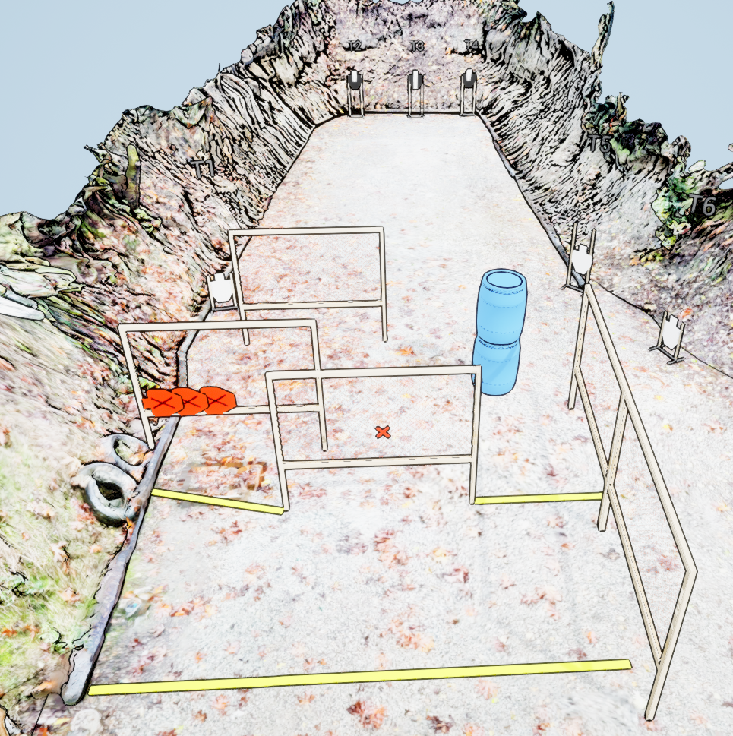
 | Stage 2 Slav Squat Standards Course Designer: Eric Beerbaum

